Slide 1
Recommendation system
Leela Sirisha Surpani
lsurpani1@student.gsu.edu

Slide 2
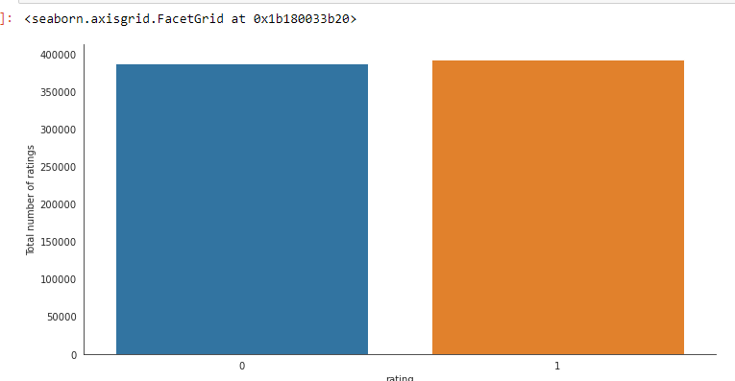
Exploratory data Analysis
Dimensionality Reduction: Deleted the columns quiz_type, quiz_number, question_number.
Null Values: Checked for null values , there are no null values in the data.
Analysing Rating:
Zero's and Ones are equally distributed.
Unique Users and products
Total no of ratings : 779920 Total No of Users : 18304 Total No of products : 5000

Slide 3
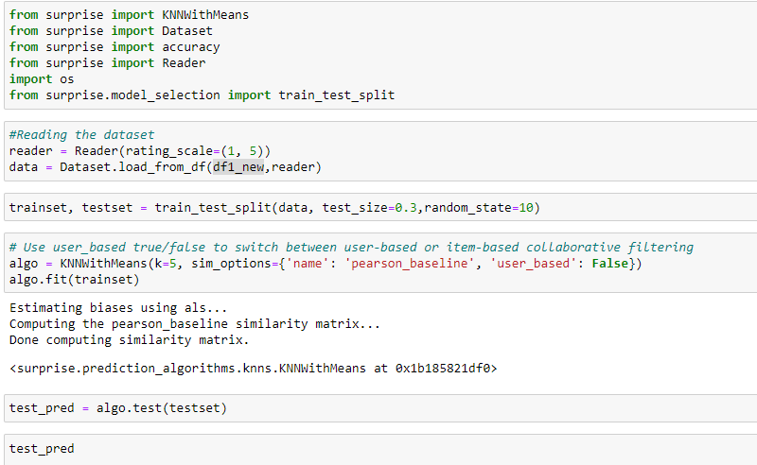
Collaborative filtering:
Collaborative filtering is commonly used for recommender systems.
Used Surprise Model and used KNNWithMeans model.
Used Train_test_split to split the data to train and test data.
Considered 70% as Train data and 30% as test data.
PERFORMANCE METRICS:
RMSE : 0.7074

Slide 4
Model-based collaborative filtering system
These methods are based on machine learning and data mining techniques. The goal is to train models to be able to make predictions.
1) Generated a ratings_matrix (pivot_table). [filled the unknown values with zero’s.]
2) Did decomposition of matrix on transpose of ratings_matrix.
3) calculated Correlation matrix from the decomposition matrix. (Correlation for all items with the item purchased by this customer based on items rated by other customers people who bought the same product)

Slide 5
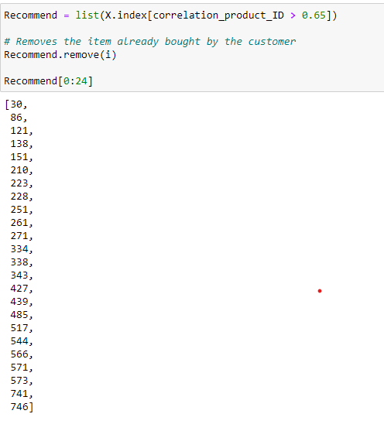
Recommendation System
1) for a user_id retrieve product id.
2) for product_ id using correlation matrix we can recommend highly correlated products in sequence.

